Slide 1
Converting Text to Unicode
2018701021
2018701022

Slide 2
Abstract
Sometimes text is available in font based encoding means the text is not in readable format. Such texts cannot be run through Machine Translation, Search engines, Dialogue systems etc.
Unicode, Inc.. which provides a solution to the localization problem of the world’s font based languages.
The goal here is to develop a converter which takes the different font encodings and convert into Unicode format.

Slide 3
Data Set
Presently handling two types font encodings, those are SHREE and Chanakya.
We have around 15 to 20 PDF files with SHREE, Chanakya font encodings. A single PDF file contains more than one font encoding, means headings in one font encoding and the paragraphs in different font encoding.

Slide 4
Our Approach
Text Extraction from PDF files
Preparing Mapping Dictionary
Tokenize the input text
Map each character to Unicode
Mapping and Normalization Rules
1
2
3
4
5

Slide 5
Data Extraction
Converted these PDF files into txt files by using PDFtoText Miner.
Each PDF file contains approximately 6000 lines of text.

Slide 6
Preparing Mapping Dictionary
Created a mapping dictionary. It contains the mappings from glyph in specific font encoding to Unicode in Devanagari.
Extracted the 210 glyphs from SHREE font and 223 from Chanakya font.
The unicode range of SHREE glyphs is U+0020 to U+02C7 and Chanakya is U+00BC to U+02C7.

Slide 7
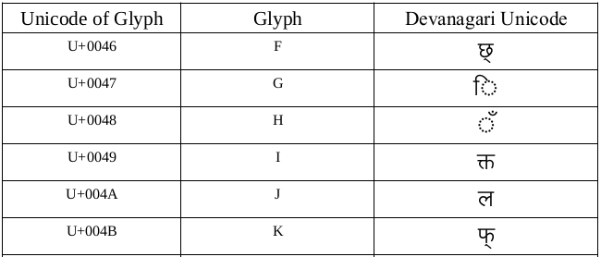
Sample Mapping Dictionary

Slide 8
Mapping Text to Unicode
Created the mapping dictionaries for different font encodings. Each dictionary contains a character symbol, corresponding glyph in that specific font encoding and corresponding Devanagari Unicode for that glyph.
Take the text, tokenize by character level and by using above mapping rules map each character to its corresponding Unicode in Devanagari.

Slide 9
Cont...
By this step will get just Unicode mapped output. In this output will get lot of miss-mappings.
By writing some additional mapping rules and normalization rules resolve the wrong mappings.

Slide 10
Additional Mapping Rules
ि करण → किरण
In above word the ि is attaching to previous character. So we need to move that halant till we get a full character/consonant.
दशर्न → दर्शन
The र् matra attaching to next character, so we need to
backward the र् matra until we get a consonant.

Slide 11
Cont..
सावभ र्ोम → सार्वभौम
Same like above problem, but here we have two problems. One is with र् matra another is ौ matra. We should attach the र् matra before the consonant and attach the ौ after the consonant.
राष्ट ीयता → राष्टीयता
The ी matra move forward until we get a consonant.

Slide 12
Cont...
हू ँ → हूँ
ज ैसे → जैसे
सार्वभ ौम → सार्वभौम
सहअिस्तत्ववाद → सहअस्तित्ववाद

Slide 13
Normalization Rules
For आ, its giving अ (Unicode) + ा (Unicode) but its not correct type of rendering. Whenever will get अ + ा, directly replace with आ.
And same type of problem. Whenever will get अ + ा + ै, normalize it with औ.
If we get ा + ै replace with ाै.
Whenever will get ा+ े replace with ो.
If we get a character ए + े replace with ऐ.

Slide 14
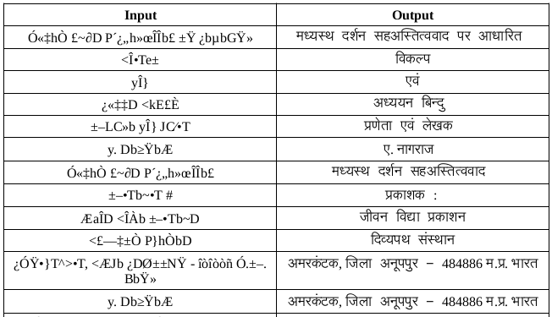
Sample Output

Slide 15
Observations
Most of the problems solved, but observed some ambiguous problems like below:
For character इ, nbspace is assigned in SHREE. And nbspace also assigned to normal space.
In Chanakya , some full characters like श, ण, ग represented by multiple characters.
श → श् + ा, ण → ण् + ा, ग → ग् + ा

Slide 16
Cont...
And one more observation is that PDF’s in different font file types like Truetype font, Type 1, Open type.
Python2.7 and Python3 variations for Unicode.

Slide 17
Thank You!

